Slide 1
Google Cloud Hackathon
—— Business Airbnb Recovery Under COVID 19
Team MHS Wenqing Hu
Zhexuan Meng
Boya Sun
Notes:
Hey guys, we are the team MHS! For this mini GCP Hackathon, we’d like give recommendation for Airbnb, whose business is highly impacted by the COVID 19 pandemic, by leveraging the GCP tool and Airbnb listing and review data.

Slide 2
TABLE OF CONTENTS
Business Case
Topic Models
01
03
Analytical techniques - GCP
Recommendations and impact
02
04
Airbnb’s challenges and opportunities under covid-19 pandemic
Beijing vs San Francisco
Airbnb reviews’ topics
BigQuery, Data Studio, Storage, AI Platform
Recommendations for survival and project impact
Notes:
In this presentation, we will go through the business case and current challenge for Airbnb under the pandemic, how we use the Google Cloud Platform big data and machine learning tools, our result of analysis and our final recommendations and estimated impact for Airbnb.

Slide 3

Business Case - policy bans on travel and rentals
Americans have been choosing to limit travel and going out, and some states and local governments have put restrictions on short-term rentals. Airbnb hosts had to adjust their rental strategy or even stop the rental business.
According to the survey conducted by IPX 1031:
47% of hosts don't feel safe renting to guests
70% of guests are fearful to stay at an Airbnb
44% decrease in revenue June-August expected by Airbnb hosts
ANADOLU AGENCY VIA GETTY IMAGES
Notes:
Faced with the increasingly serious situation and more and more confirmed cases, countries around the world have issued shelter-in-place policies, travel and cross-border tourism has been greatly reduced.
In the United States, the short term(i.e., vacation) rental business is limited hugely. According to the survey conducted by IPX 1031, 47% of the Airbnb hosts don’t feel safe renting to guests while 70% of guests are fearful to stay at the Airbnb listing. In addition, the Airbnb host expected 44% decrease in revenue from June to August this year.

Slide 4
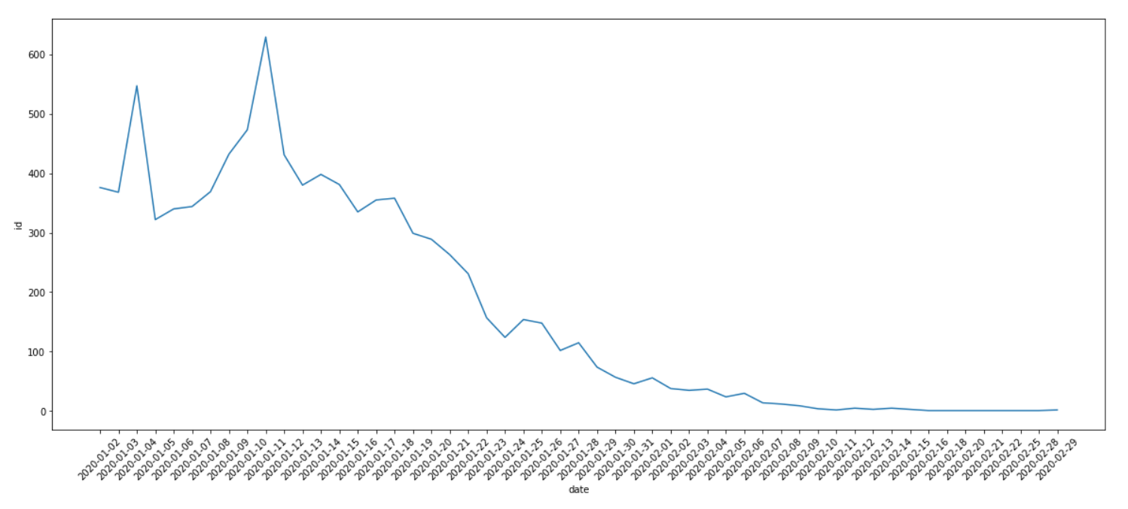
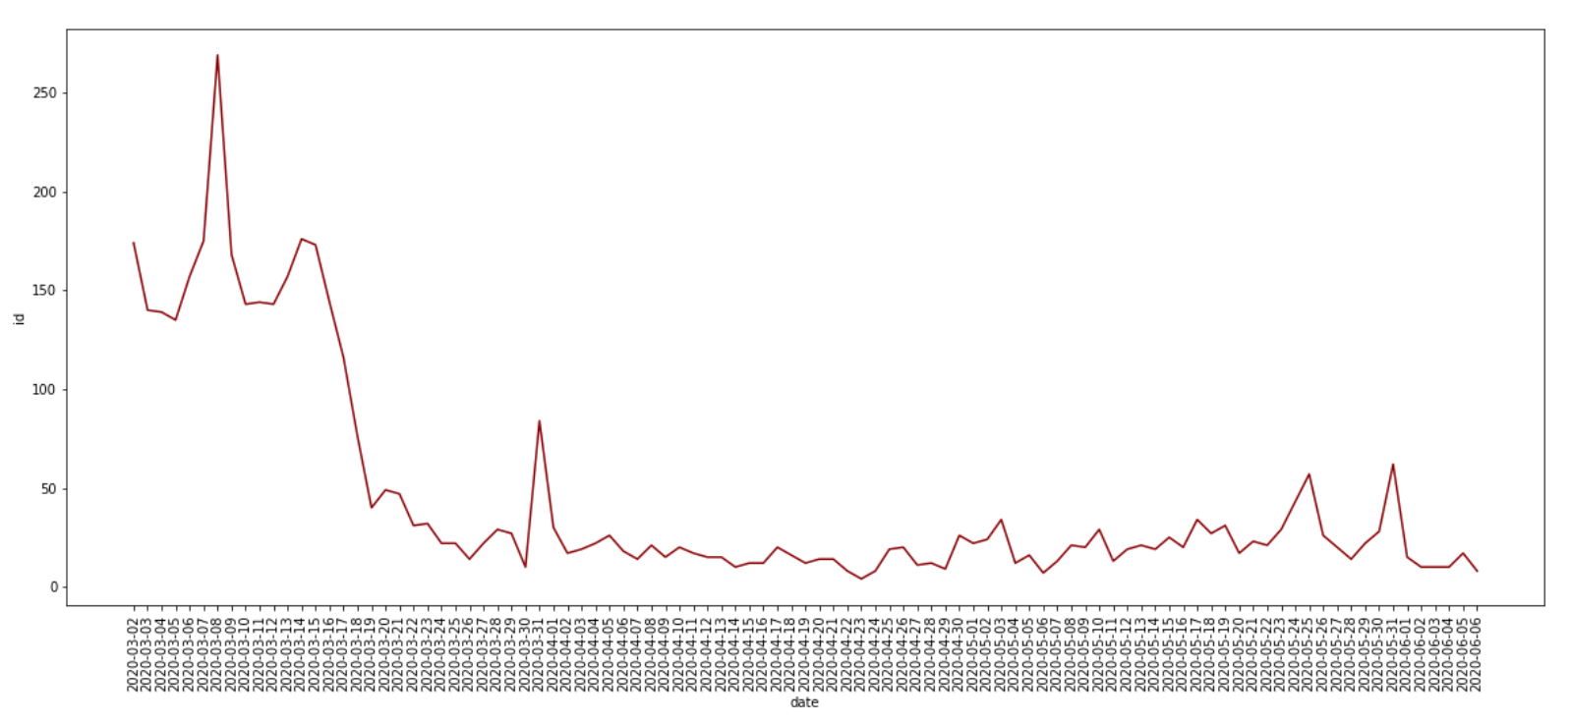
Challenges - globally significant reservation drops during covid-19
Beijing had the very strict stay-at-home policy
Beijing: Covid-19 in control after March
SF “shelter-in-place” policy started
SF removed the 1st phase ‘shelter-in-place’ order
Notes:
During the pandamic, the reservation volume for rental has hugely decreased by policy restriction as well as people’s awareness of security. Let’s look at two major cities in China and the United States. In Beijing,China, the reservation keeps at lowest level as the beijing government had the very strict stay-at-home policy. Meanwhile in San Francisco, the reservation volume hugely dropped after the SF government ‘shelter-in-place’ policy. However, after SF removed the 1st phase of ‘shelter-in-place’ policy, people seem to start traveling and the reservation resumed a little.

Slide 5
Seek Opportunity
Victory!
Markets that haven’t recovered
Markets that almost recovered
Dominant markets for North America has not recovered yet from the pandemic.
Some countries have almost recover from the COVID 19 and have resume the trips, like China.

Slide 6
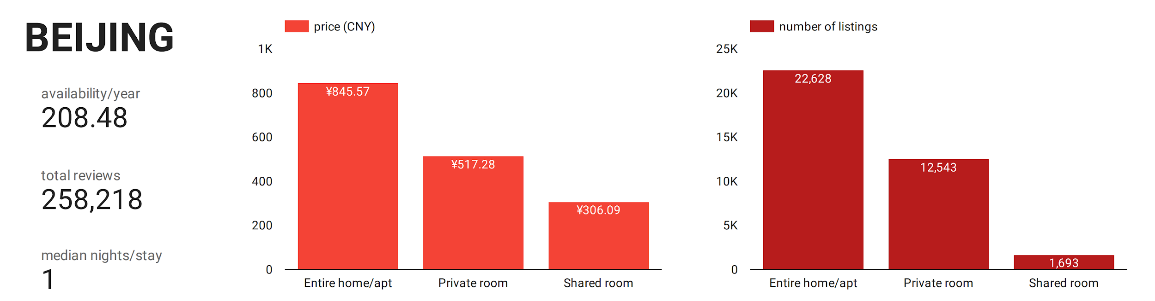
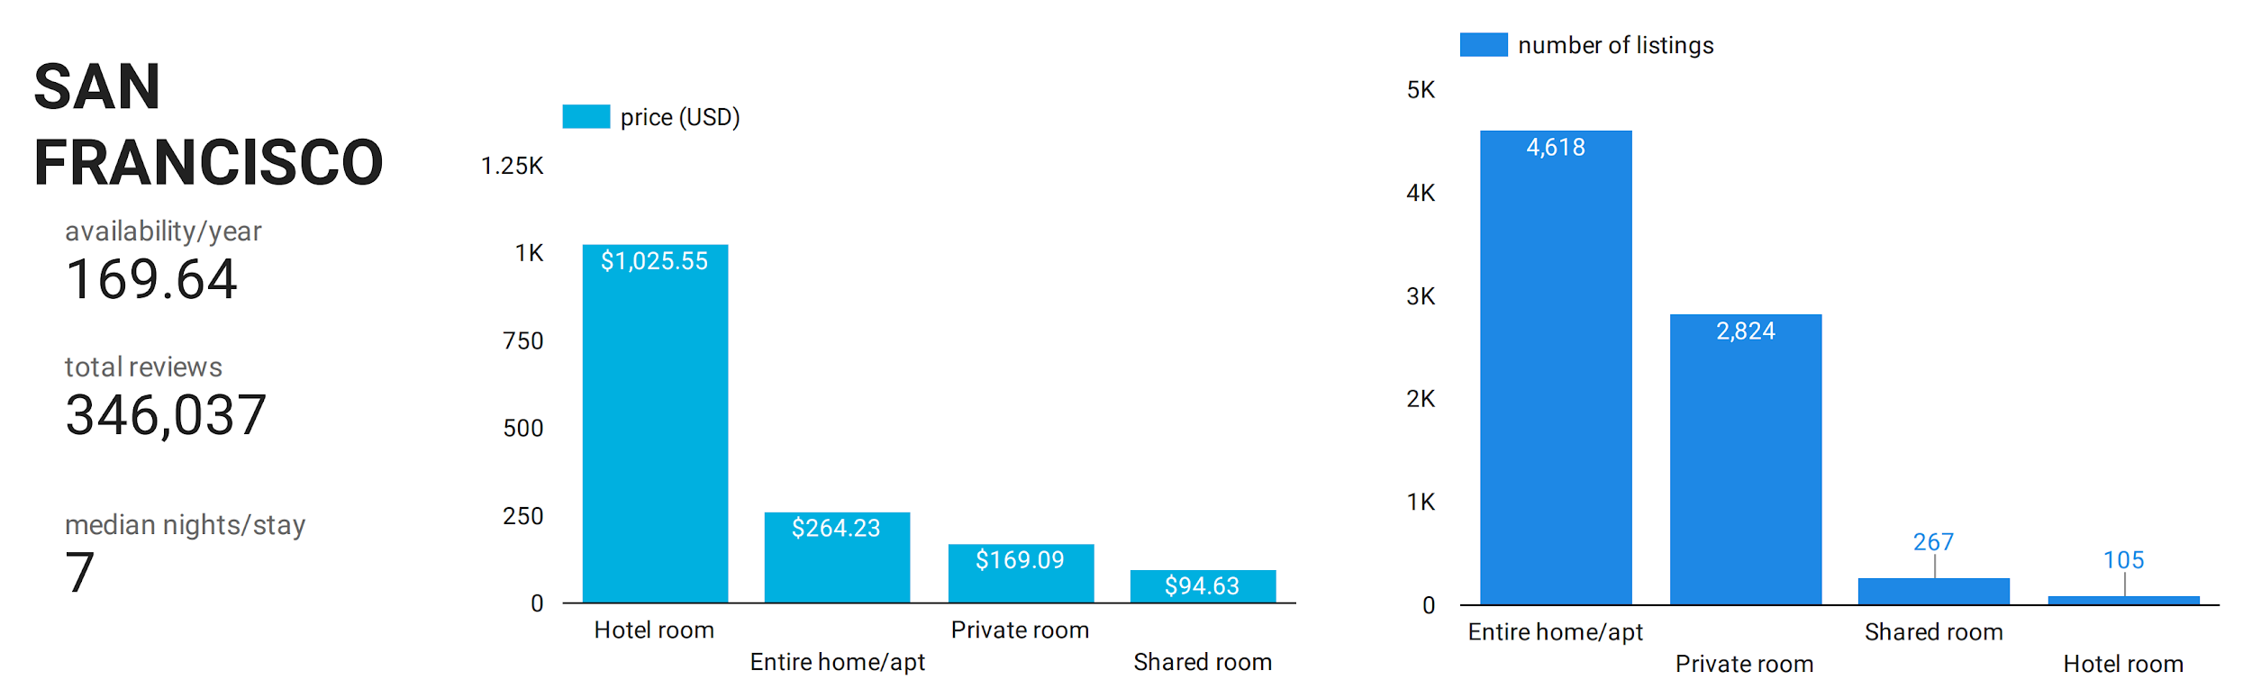
Notes:
#Made with GCP Data Studio#
We will focus on two city: Beijing and San Francisco to compare the current market for region that has been almost recovered and region that is still under lockdown. By going deeper regarding the market size, customer review, we hope to gain insight of the strategy that can help Airbnb gain more revenue in the crisis.
From the chart above, we noticed that although Airbnb has more listing in Beijing than in San Francisco, the occupancy is relatively low in Beijing: the median length of stay in Beijing is only 1-day, while it’s 7 days in San Francisco. The price is also lower
Data Source: http://insideairbnb.com/get-the-data.html

Slide 7
Analytical techniques - GCP
BigQuery
Data Studio
AI Platform
Conducted preliminary analysis on (1 GB, 100+ feature) data and explored the characteristics of datasets
Visualized data based on BigQuery’s results
Applied Google Cloud NLP API and Chinese tokenizer Jieba; Used GCP notebook to run topic models
Notes:
We have three analytics phases. First, we imported datasets to Google cloud storage, the overall size of all datasets accumulated to 1 GB + and number of features was over a hundred. In the exploratory analysis stage, an efficient and easy-to-use tool will be important. So we chose to use BigQuery to retrieve and play with the data. After understanding the table structure and data types, since the Data Studio was directly linked to BigQuery, it was used to do visualization for convenience. Different types of figures such as line plots, bar charts, and dashboard tables were explored for better expression. In the last phase, the model development and deployment were completed on the AI platform. There are many useful google cloud APIs, which helped improve coding efficiency. The only problem was there were some Chinese texts in our analysis but there was not direct API for Chinese words analysis. This problem could be solved by importing other python packages. Overall speaking, GCP’s computational time and query efficiency are much higher than using some other techniques.

Slide 8
Exploratory data analysis & Model

Slide 9
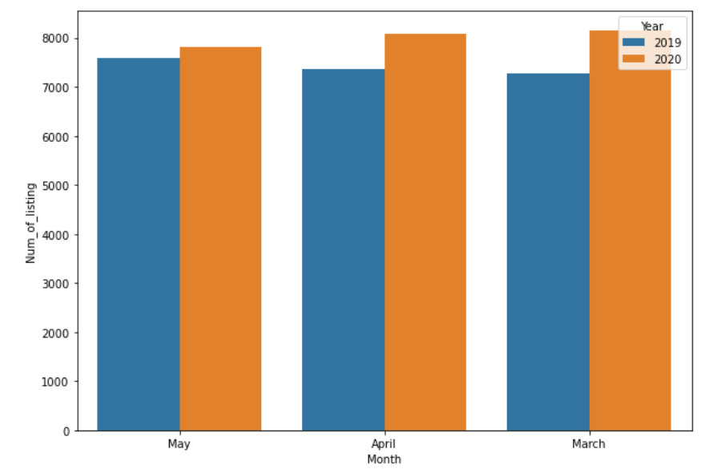
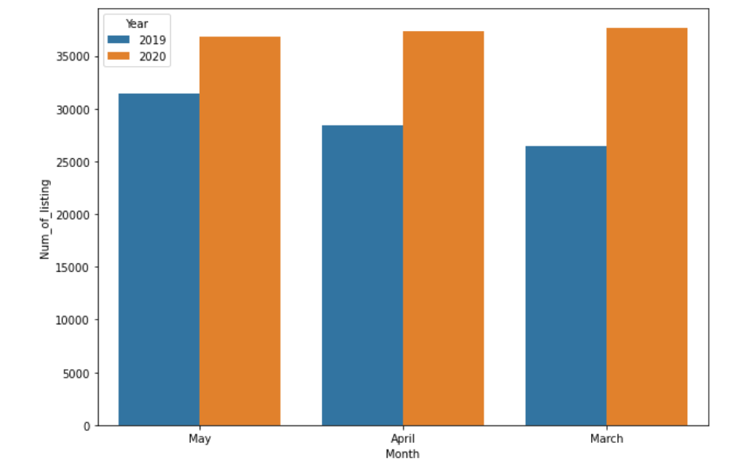
Beijing vs. San Francisco
Listing number change under pandemic
Number of listings in SF before and after COVID 19 pandemic
Number of listings in BJ before and after COVID 19 pandemic
Notes:
By comparing the number of listings in Airbnb platform in March-May, 2019 and 2020, we found that 1. Number of listing in Beijing is way more than listing in San Francisco.
2. The listing amount didn’t change a lot. Both cities saw increase of listing both from 2019 to 2020 and during the pandemic.

Slide 10
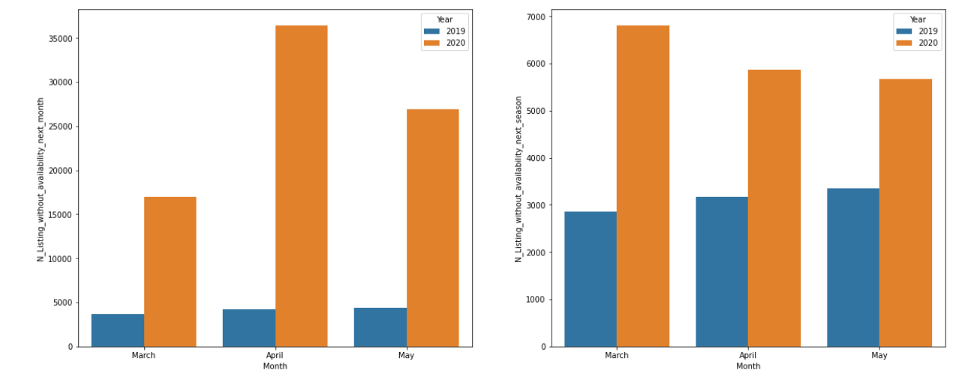
Beijing
Availability change under pandemic
Number of listings with 0 availability in the next month
Number of listings with 0 availability in the next season
Notes:
Although the number of listing seems normal, we may ignore a important factor when only looking at the number of listings. Some hosts don’t give up to their listing and the business, so they close the availability of the listing (i.e, the listing can still be searched on the platform but the customers cannot book the place in the near future.)
Thus, we further take a look at the availability change in 2019 March-May as well as 2020 March-May. We are quite surprised by that huge number of the listing are temporarily closed in Beijing. Although it’s closed for now, it indicates the huge potential of Chinese market in the future after people resume the faith in traveling.

Slide 11

Beijing - review score distribution in 4 aspects
Notice: The review scores regarding to the cleanliness is not as good as other aspects
Notes:
To analyze the customer feedback, we first analyze the distribution of review score of four aspects. We found that the listing in Beijing is lower than other aspects, for example communication. This is a critical factor especially under the COVID-19 pandemic when people care about the cleanliness more than ever.

Slide 12
Beijing - topics model
Facilities & household items
experience & cleaness & attitude
Topic 1 words
房东, 热情, 沟通, 回复, 贴心, 舒服, etc.
(English: host, welcoming, communication, reply, considerate, comfortable)
Topic 3 words
卫生, 价格, 热水器, 马桶, 床垫, 沙发, 床单, 枕头
(English: sanitation, price, water heater, toilet, mattress, sofa, sheet, pillow)
Topic 5 words
性价比, 新, 解决,建议, 打扫, 味道, 隔音, 态度
(English: price-performance ratio, new, solve, help, suggest, clean, smell, sound, shower, attitude)
Host & Communication
Topic 2 words
住, 民宿, 风格, 朋友, 胡同, 设计, 用心, 客厅, 睡
(English: live, homestay, style, friends, Beijing Hutong, living room, sleep)
Topic 4 words
地铁站, 交通, 地铁, 小区, 便利, 很近, 好找, 步行
(English: subway station, transportation, community, convenient, near, easy to find, walk)
Design & Layout & Style
Location & Convenience
Notes:
Since international trips are banned, we would like to learn more about local people’s attitudes and experience with Airbnb, so only Chinese reviews (near 20k records) were filtered out to build the topics model. We tried topic numbers from 2 to 10 and determined 5 since it gave highest coherence score. Inferring by the representative words, 5 topics were summarized: host & communication, design & layout & style, facilities & household items, location & convenience, experience & cleaness & attitude. This topics indicate that people in Chinese market cares about the interaction with hosts, the design of the room, facility efficiency, room cleaness, and location. This topic results also confirmed the previous exploratory analysis where we found users were sensitive to cleaness. In the future, Airbnb could also furtherly conduct sentiment analysis based on these topics and look at reasons of lower reservation rates in China.

Slide 13
San Francisco - topics model (before vs after)
Before Covid-19
After Covid-19
Topic 1: nice, clean, everything
Topic 2: host, space, home, room, neighborhood
Topic 3: place, stay, location, comfortable
Topic 1: enjoyed, spot, public, kitchen, access
Topic 2: great, place, clean, nice, comfortable
Topic 3: room, bathroom, check, private, kitchen, bed
Topic 4: location, restaurants, convenient, walking, distance
Topic 5: easy, close, quiet
Notes:
Comparing the reviews given before and after covid 19, before the covid-19, guests cared more about cleanliness, surrounding environment and location of the houses; after the covid-19, users tended to give more reviews regarding the facilities and spaces inside the room. So during the post covid 19 period, cleanliness in the room will still be a top theme.

Slide 14
Recommendation for Reopening
Sanitation
Cooperation
Domestic Travel
Countryside Tour
Highlight safety and cleanliness score to provide assurance to guests
Work with local medias and platforms to promote campaigns
Encourage people to go on nearby trips after lockdown restrictions lift
Encourage people to explore countryside spots that are less crowded
Notes:
Based on the model results and our research, we have several recommendations for Airbnb to reopen their business in countries where lockdown restrictions has/are to lift. As it reopens its business in China, investors expect new bookings at the end of 2020 to increase by 185% comparing to that at the beginning of 2020. Airbnb can refer to its experience in China to set reopening strategies for other markets.
Sanitation: According to our topic model, sanitation and cleanliness is of the top concerns especially in the post virus phase. We recommend Airbnb to highlight safety and cleanliness score on their app or webpage for qualified hosts to provide assurance to guests.
Cooperation: Airbnb’s cooperation with one of the popular video sharing app Kuaishou in China has successfully helped it promote new initiatives. We recommend Airbnb work with popular local platforms in different markets to attract hosts and guests.
Domestic Travel & Countryside Tour: While Airbnb is already promoting domestic travel and countryside tour all over the world. Its experience in China indicates that these two strategies work and that partnering with local government departments of tourism can more efficiently promote the initiatives.

Slide 15
THANKS
Do you have any questions?

